Slide 1

Dorchester Bay
Neighborhood Business Loans
Johnny Charles, Director of Economic Development
Lending Team:
Brenda Bobadilla, Junior Loan Officer
Anthony Ciavattone, Loan Officer

Slide 2
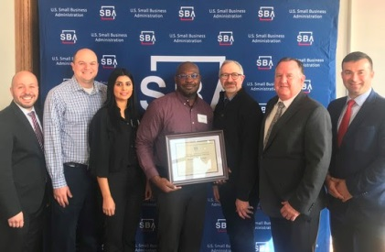

2019 Recap!
Massachusetts
Breakout Microlending Intermediary of the year!
Originated 30 Loans
Closed 28 Loans
Lent $278,650
Jobs Created/Retained
  60 Created
  64 Retained

Slide 3

How did we get HERE?
Dorchester Bay EDC
Dorchester Bay Neighborhood Loan Fund
  Strategic Goals
  Consultant Reports
  Marketing
  Online Platform
Loan Opportunities

Slide 4
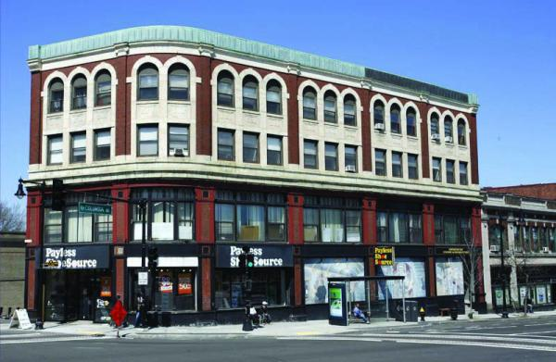
Dorchester Bay EDC
Founded in 1979
Built or preserved 1,114 affordable rental & owner occupied homes
Developed 164,260 SF of commercial space, which created 327 jobs
Built 36,000 SF Borstein and Pearl Food Production Center which created 120 jobs
Provided 7.5M in small business & home improvement loans which created 850 jobs
Developed an award winning re-entry program to support ex-offenders, placing more that 350 individuals in jobs while maintaining recidivism rate of less than 7%
Supported more that 2,840 local youth & adults in a variety camp, after school, technology, community organizing and leadership development programs

Slide 5
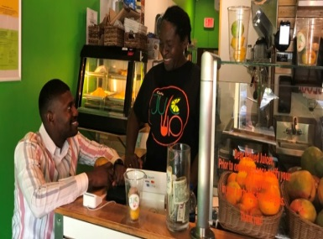
Dorchester Bay
Neighborhood Business Loans
Building Community. One Business at a Time.
A Small Business Administration (SBA) micro lender
A Community Development Finance Institution (CDFI) certified by the US Treasury
Since 1992 we’ve made loans totaling $7 Million
We’ve help create or retain 700+ jobs
Provide free, pre and post loan technical assistance to existing and start-up businesses

Slide 6
How our work syncs with DBEDC’s Strategic Priorities
Priority #1: Deploy a holistic, equitable approach to community development by increasing the number of vibrant and growing small businesses that align with community needs
Priority #2: Increase resident leadership, civic engagement, and public policy advocacy
Priority #3: Enhance the prospects for social and economic mobility for residents by helping them build their own economic power and promote social mobility so that they have more choices. We will support residents’ ability to stay in the community with or without a housing subsidy through financial education, better employment, and pathways to homeownership.
Priority #4: Ensure that DBEDC is a strong, nimble, and sustainable organization with the infrastructure and capacities to reach our vision

Slide 7
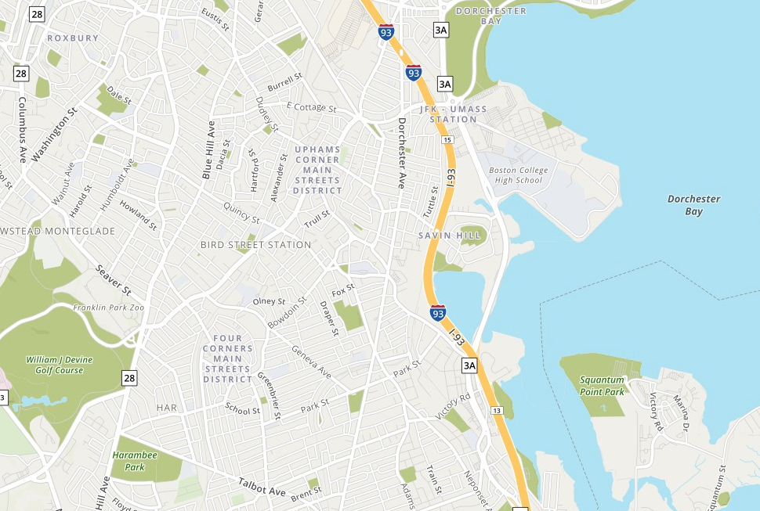
Our Lending Roadmap
High Impact Financial Financial Analysis
FinePoint Associates, LLC
Notes:
High Impact help lenders and investors build and maintain high-performing community development portfolios. They specialize in loan underwriting and consulting that improves risk management, builds capacity, and increases the efficiency of mission-focused lenders and investors.
FinePoint is a Massachusetts-based consulting firm with clients throughout the United States. Their economic development consultants and affordable housing finance experts provide specialized technical services to public agencies, nonprofits, real estate developers, financial institutions, business organizations and social enterprises.

Slide 8
High Impact Financial
Financial Analysis
FinePoint Associates, LLC
High Impact help lenders and investors build and maintain high-performing community development portfolios.
They specialize in loan underwriting and consulting that improves risk management, builds capacity, and increases the efficiency of mission-focused lenders and investors.
FinePoint is a Massachusetts-based consulting firm with clients throughout the United States.
Their economic development consultants and affordable housing finance experts provide specialized technical services to public agencies, nonprofits, real estate developers, financial institutions, business organizations and social enterprises.

Slide 9
High Impact Financial Analysis

Slide 10
FinePoint Associates, LLC
Estimated Market Size
Demand-Unmet Financing Need in Focus Neighborhoods
There are approximately 3,000 target businesses in our focus neighborhoods
1,000 of those businesses are female owned
1,300 are minority owned
Aggregate Unmet Need in our Focus Neighborhoods
$ Volume of Unmet Financing Needs (assuming average loan of $14,000) | $3 Million
$ Volume of Unmet Financing Needs (assuming average loan of $22,500) | $4.8 Million
Average # of loan inquiries per loans closed 7.6

Slide 11
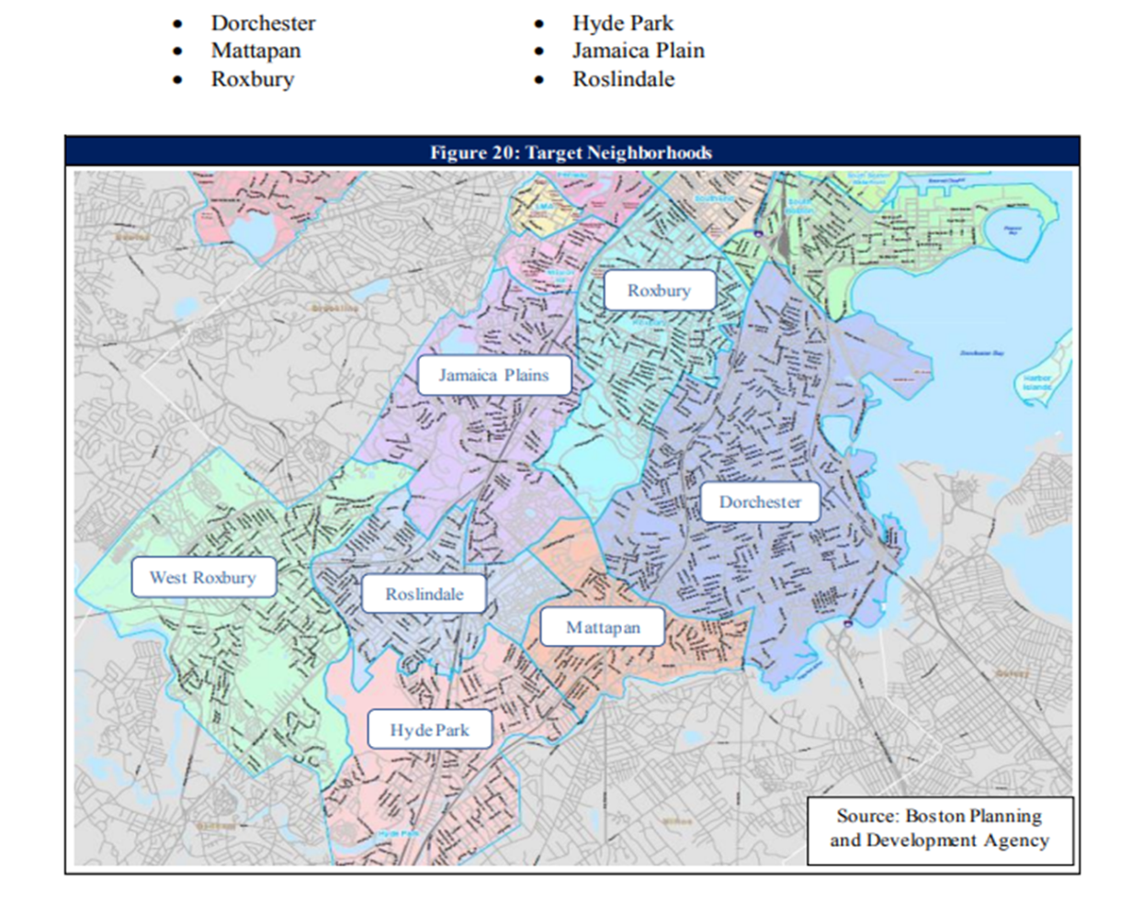


Marketing Plan

Slide 12


Slide 13
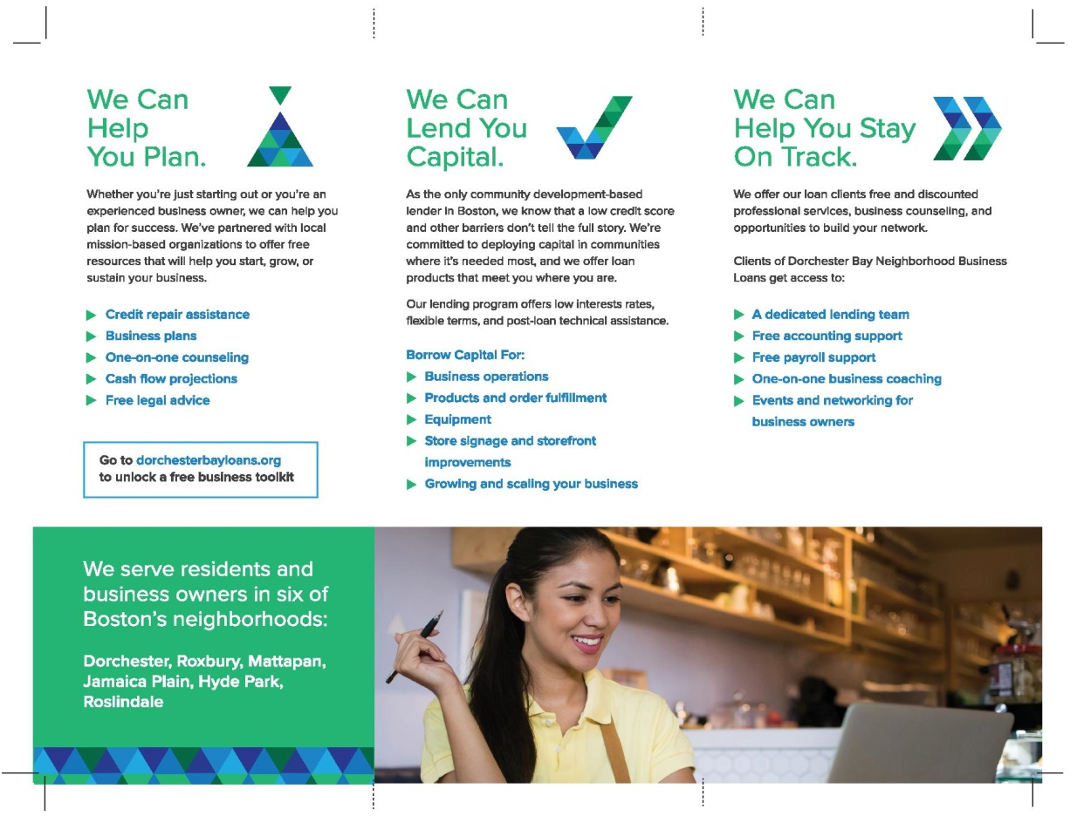
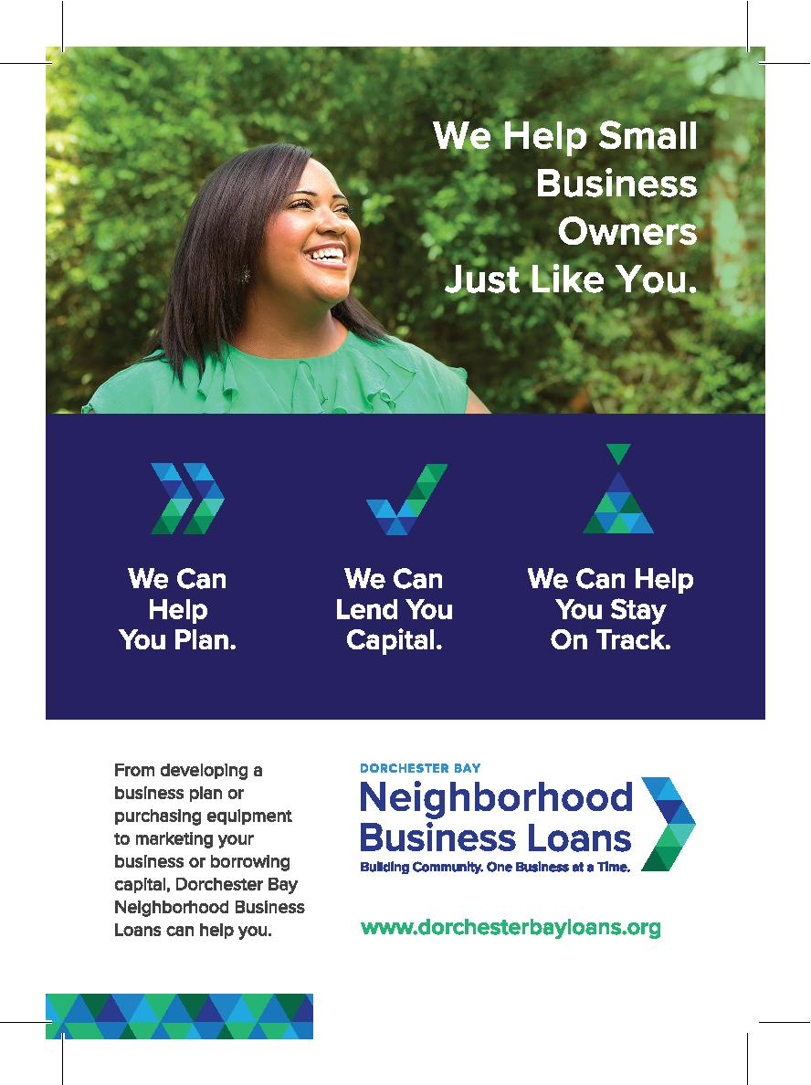
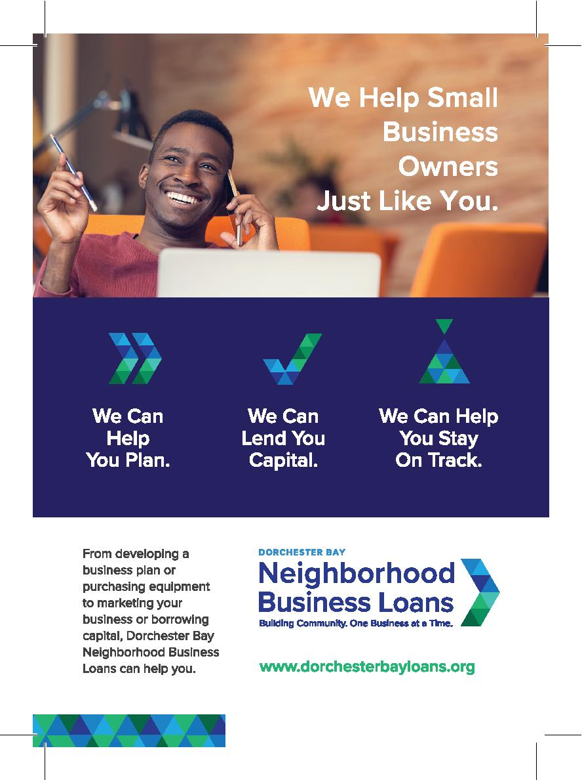
Marketing Collateral

Slide 14
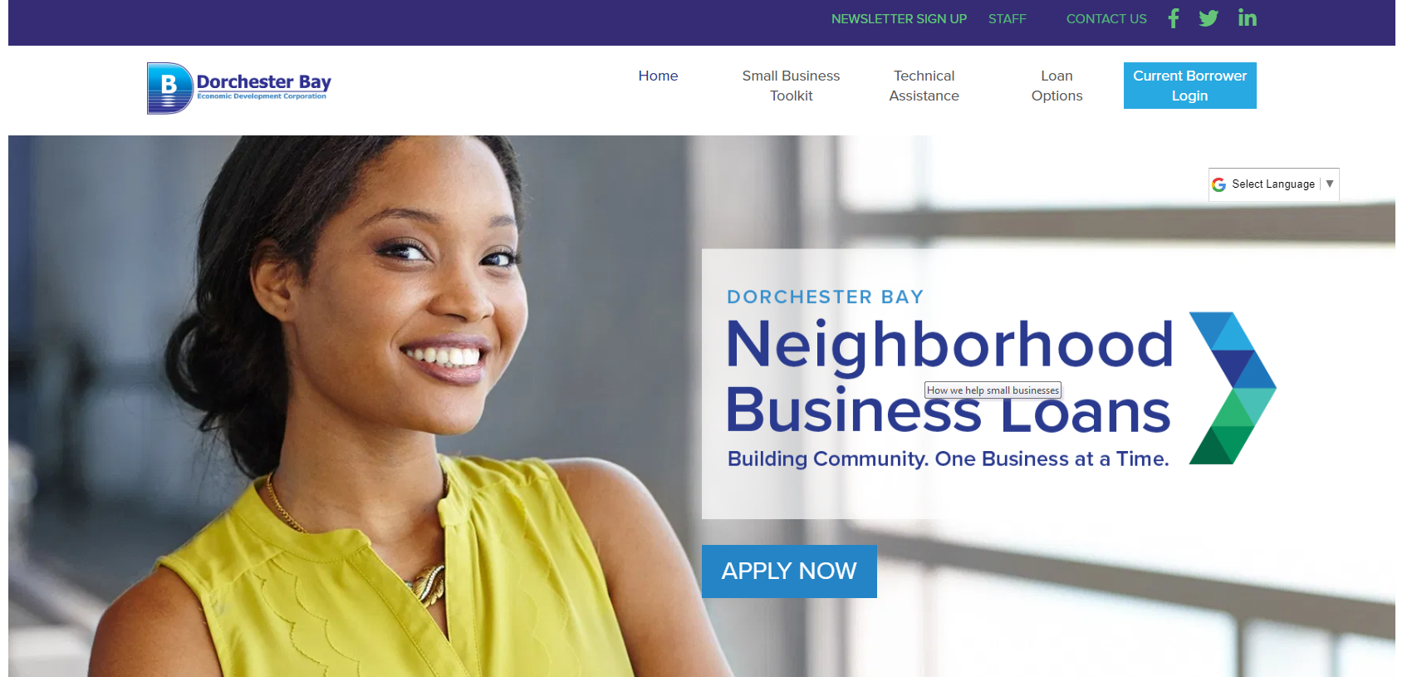
dorchesterbayloans.org

Slide 15
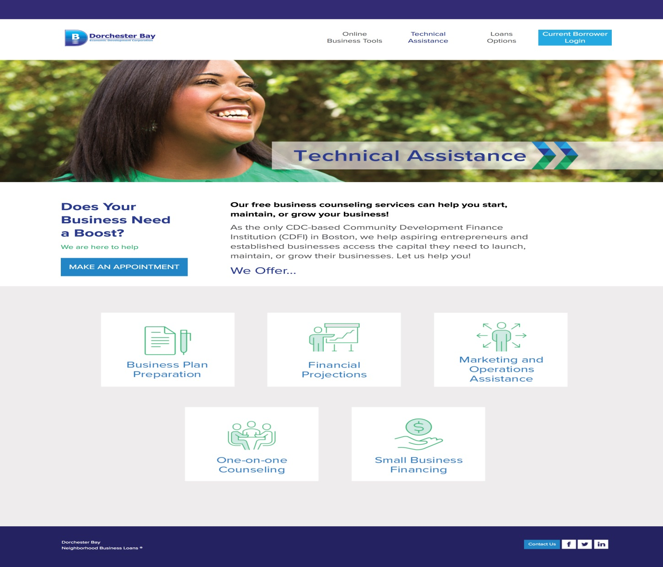

Slide 16
Loan Options
Dorchester Bay Neighborhood Loan
ReStore Boston
Store Front & Signage
Quick Capital
Up to $250,000 (with co-lenders)
7% interest rate for up to 5 years – no prepayment penalties
3% origination fee (plus any applicable state/city filing fees)
Must be a resident or business in Dorchester, Roxbury, Mattapan, Hyde Park, Roslindale, or Jamaica Plain
  Loans for signage and storefront improvements
  7% interest rate for up to 5 years – no prepayment penalties
  3% origination fee (plus any applicable state/city filing fees)
  Loans can be repaid through the reimbursable grants through the City of Boston’s ReStore program
  Funding for Businesses in Dorchester, Roxbury, Mattapan and Roslindale
Up to $20,000
Decision in 2 business days
6% interest rate
Credit score must be 680 or higher
Available to businesses in all Boston neighborhoods

Slide 17
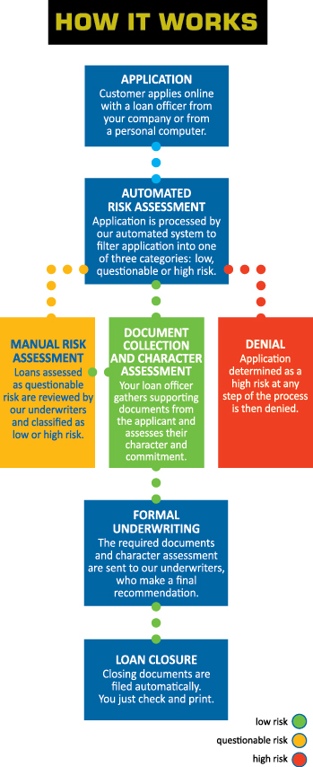
Microloan Management Services (MMS):
Online lending platform from the Lift Fund – like us, an SBA micro lender and CDFI, with 20 years experience writing $250,000,000 in loans, $24,000,000/year.

Slide 18
Microloan Management Services (MMS):
Online lending platform from the Lift Fund – like us, an SBA micro lender and CDFI, with 20 years experience writing $250,000,000 in loans, $24,000,000/year.

Slide 19
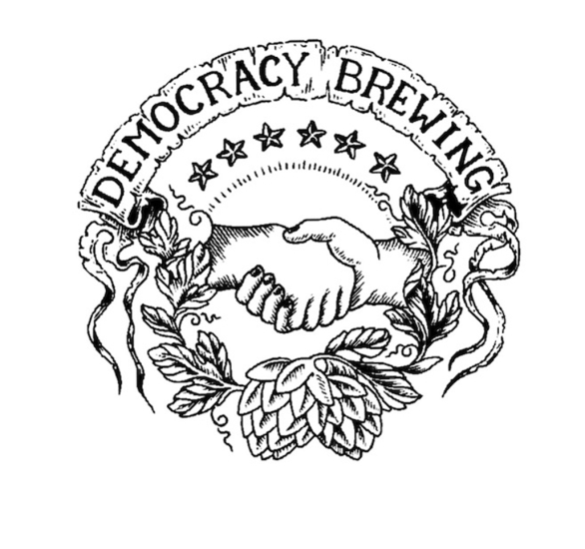





Small Businesses
JaMa Professional Cleaning
Superior Commercial Cleaning Solutions

Slide 20


Slide 21
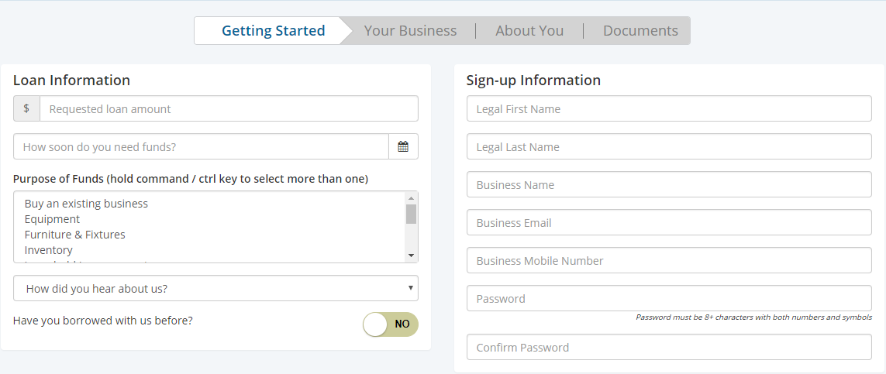
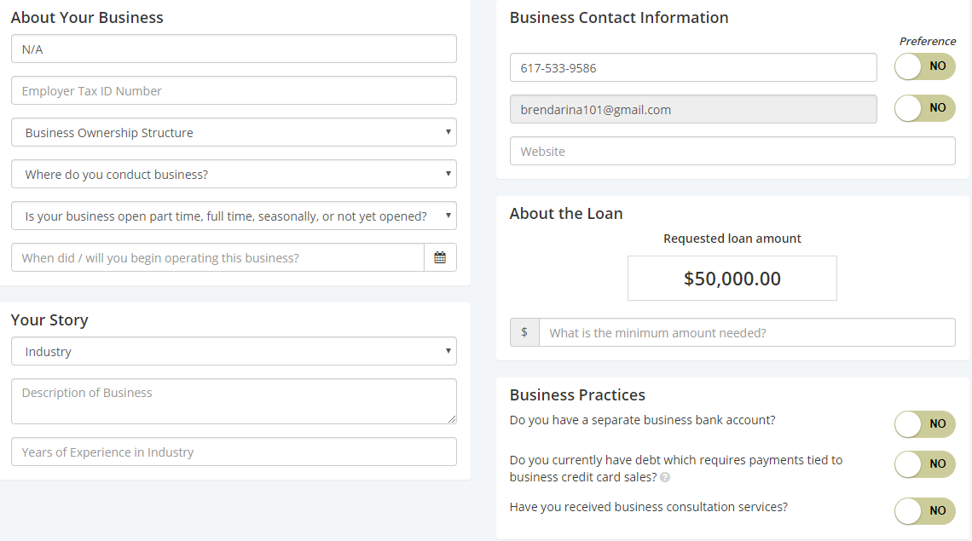
Our Online Application Process

Slide 22
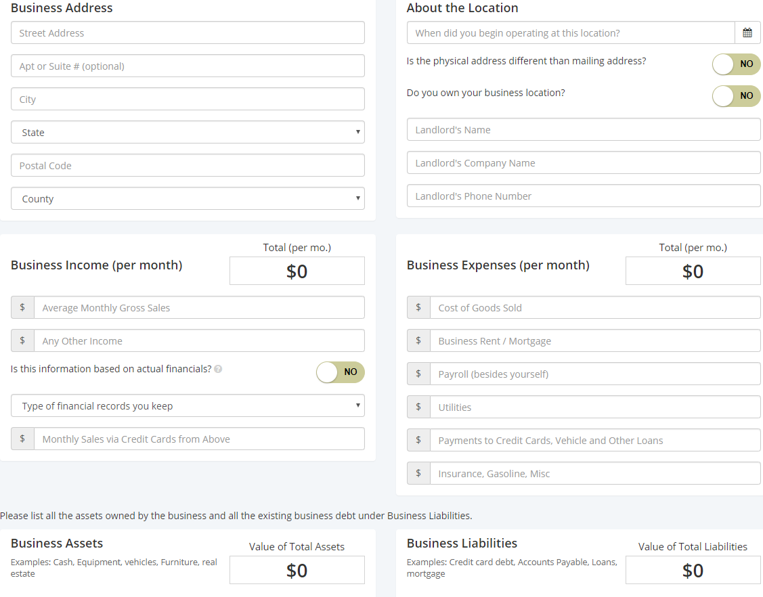

Slide 23
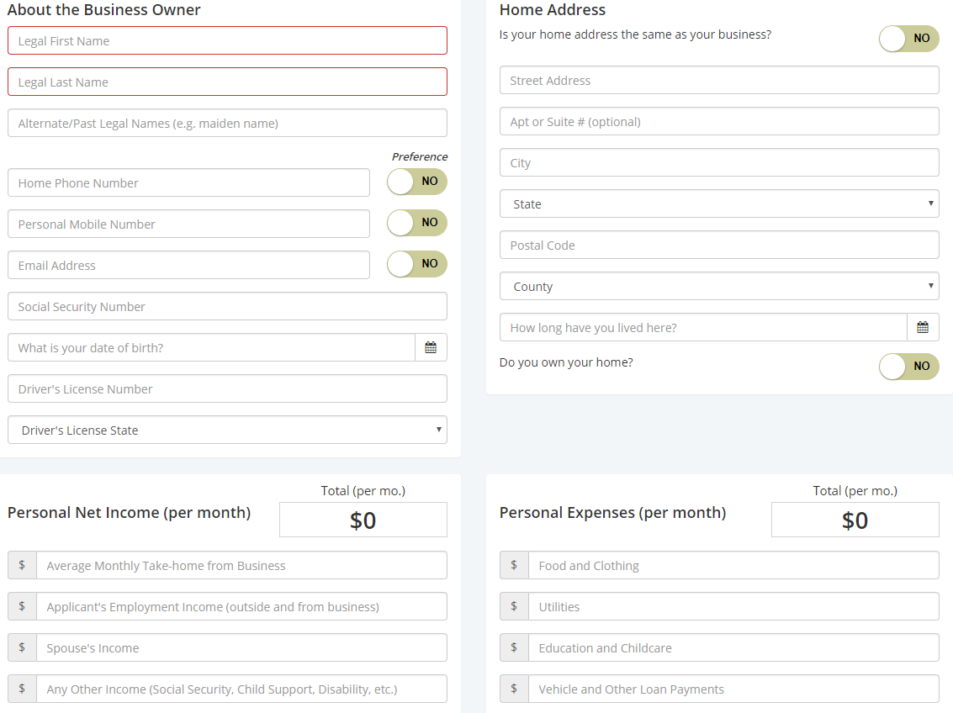
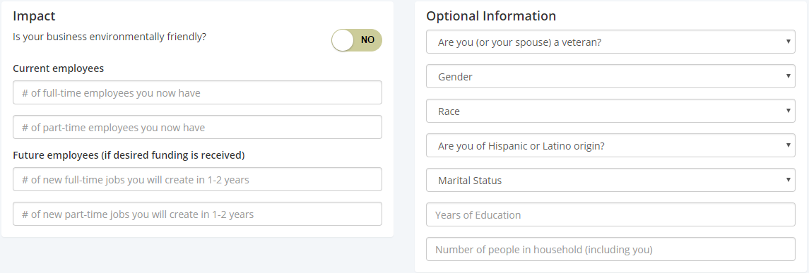

Slide 24
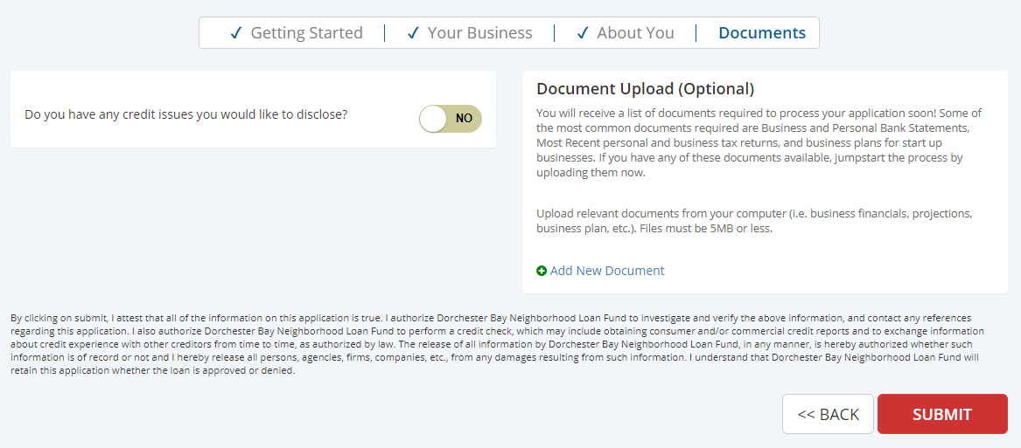
Final Step in the Process

Slide 25
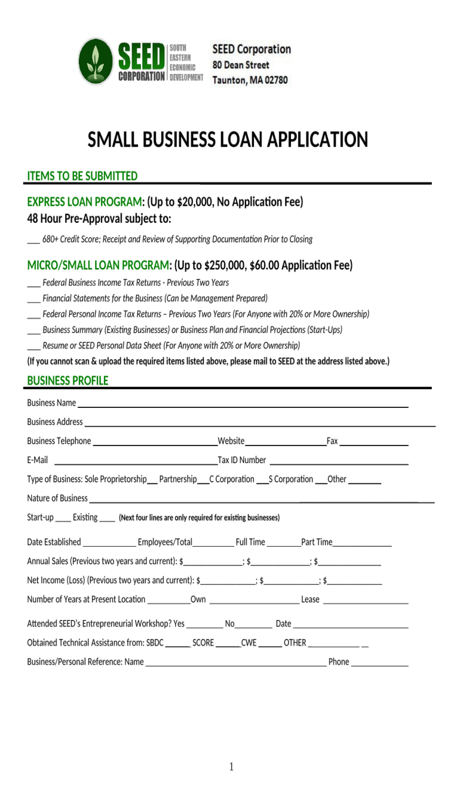
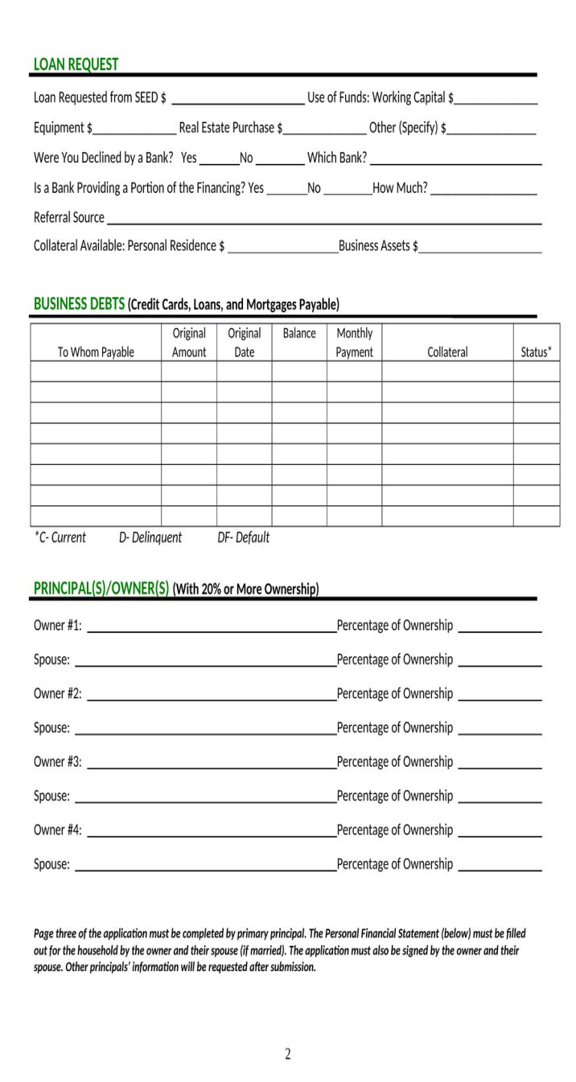
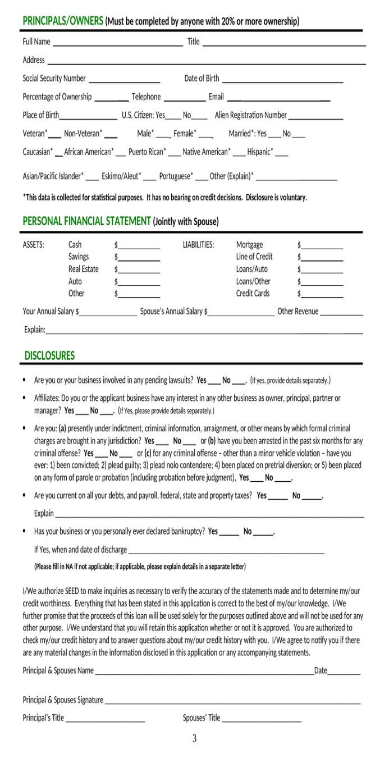
Application Process: All Boston Neighborhoods outside DBNLF’s servicing area. There is a $60 Application fee for loans over $20K

Slide 26
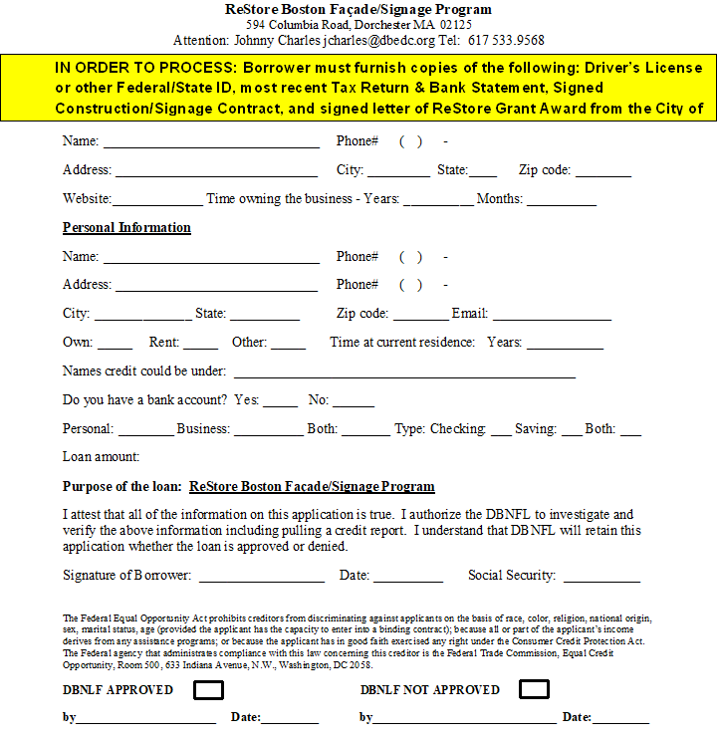
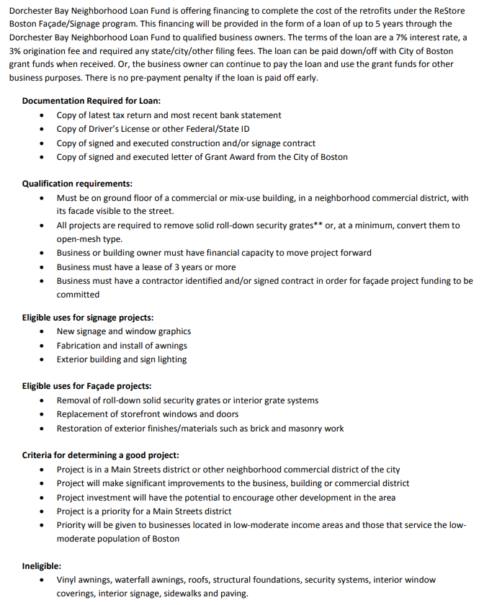
Application Process ReStore:

