Slide 1
Mortgage Lending Committee
May 21, 2019 Meeting

Slide 2
AGENDA
3:00pm Welcome and housekeeping
Minutes of the Meeting of April 9, 2019
Back in Boston for our next 2 meetings!
3:15pm MCBC Mortgage Lending Report Update
3:30pm Kathryn Madden, AICP, Professor IDCE, Clark University
Overview of the housing market in Worcester
3:45pm Curtis Wiemann, City Planner, City of Holyoke
Overview of the housing market in Worcester
4:45pm Updates & Announcements
Committee Working Groups

Slide 3
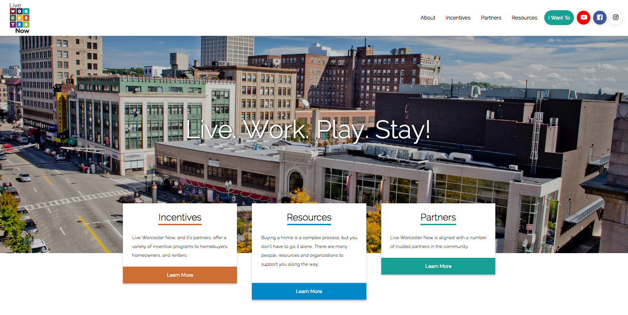
April 9th MCBC MLC Meeting
Meghan Venable-Thomas,
Enterprise Community Partners
Undesign the Redline Exhibit at Boston Architectural Center
Video of Undesign the Redline in Bronx
Mapping Inequality – interactive website with HLOC maps
MCBC Lunch & Learn – April 23rd
Tania Medina, Board Chair, Live Worcester Now
History & Overview of Live Worcester Now
How to join Live Worcester Now
Upcoming Events

Slide 4
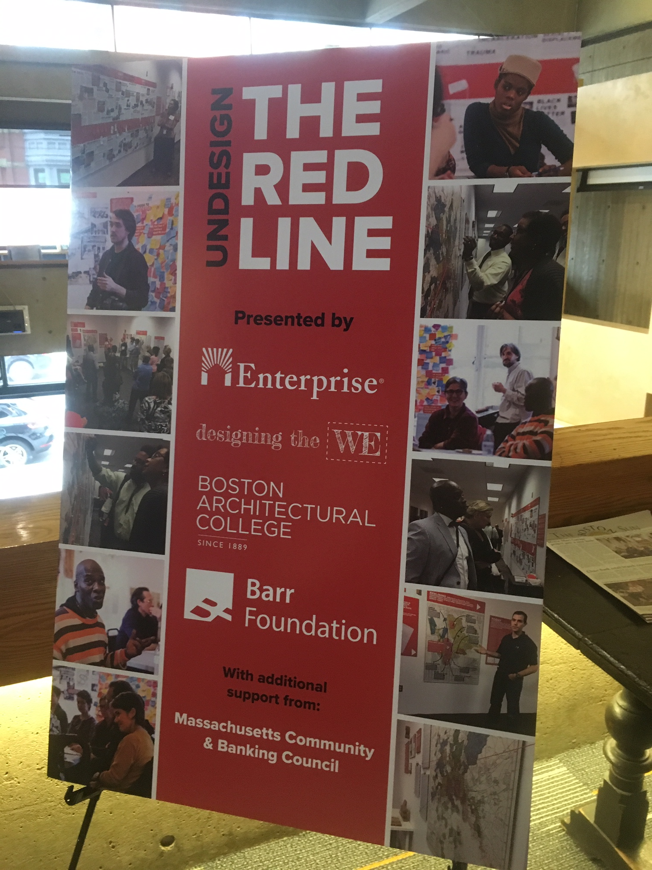
Undesign the Redline

Slide 5
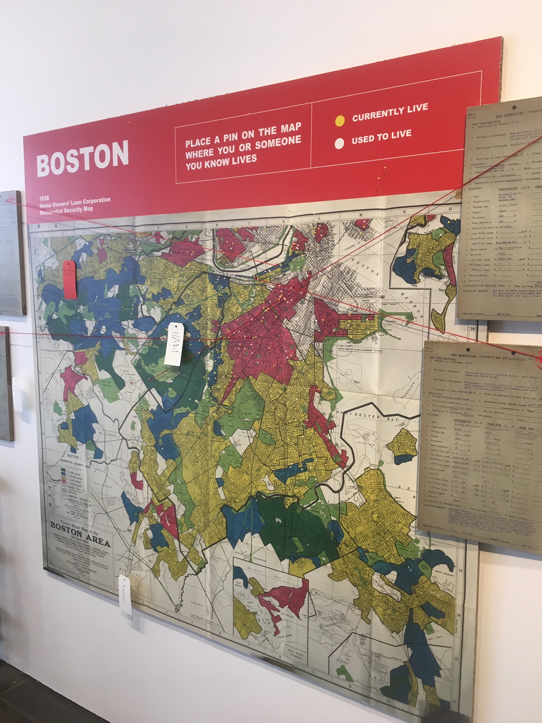
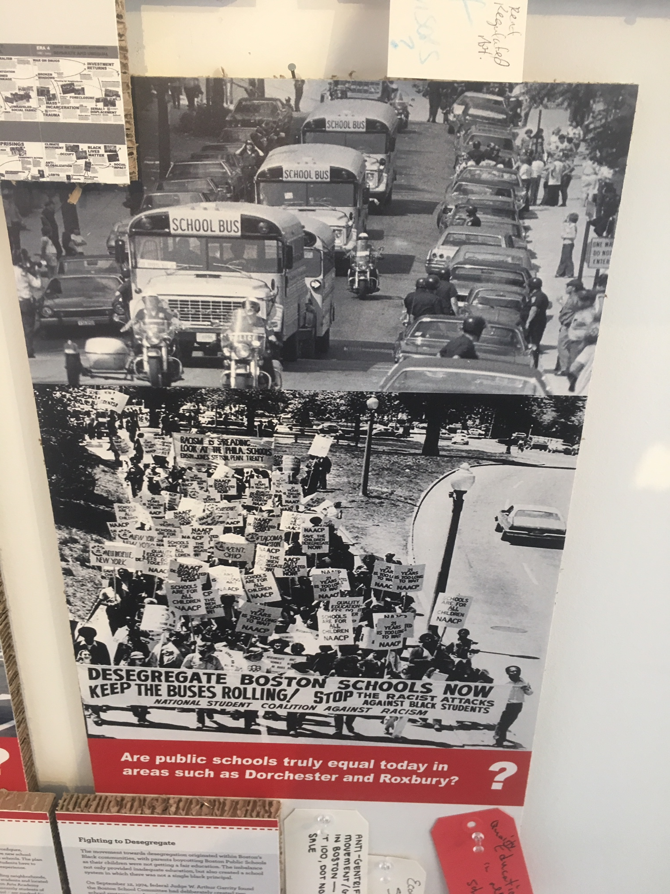
Undesign the Redline

Slide 6
Dates for 2019 Meetings
Mortgage Lending Committee | Location
Tuesday, January 22 | MHP (Boston)
Tuesday, February 26 | MHP (Boston)
Tuesday, April 9 (3-5pm) | People’s United (Worcester)
Tuesday, May 21 (3-5pm) | People’s United (Worcester)
Tuesday, July 9 | MHP (Boston)
Tuesday, September 17 | MHP (Boston)
Tuesday, October 22 (3-5pm) | People’s United (Worcester)
Tuesday, December 3 (3-5pm) | People’s United (Worcester)
https://conta.cc/2R3B4WJ

Slide 7
MCBC Mortgage Lending Report Update
Today: Overview of the existing report and new HMDA data
HMDA data
Changing Patterns report, other examples – including today’s speakers!
Demo of MCBC's Small Business Lending Data Project in Tableau
June 13th – Data in Society
Data literacy, digitization, & visualization
Data inclusion (controlling for bias; using an equity inclusion lens w/ big data sets)
July 9th - Mortgage Lending Committee Meeting
Pen to paper edit a draft RFP/RFQ
RFP Issuance July 12^{th -} responses due by July 26th
August 9th - Announce Mortgage Lending Report RFP Selection
Status meetings: August 14th, August 21st, September 11th, September 17th
October 1st – Final Draft of Mortgage Lending Report
October 16th – Mortgage Lending Report Release
October 30th - Mortgage Lending Forum
Fall/Winter 2019 – MCBC Mortgage Lending Report on the Road

Slide 8
MCBC Mortgage Lending Report Update
Today: Overview of the existing report and new HMDA data
HMDA data
HMDA Data Submissions were due March 1, 2019
HMDA Modified Loan Application Registers (LARs) data published April 2, 2019
Later this year additional information will be published: a complete loan level dataset, HMDA aggregate data reports, HMDA individual institution disclosure reports.
HMDA Reporting Getting it Right
Goals for MCBC Mortgage Lending Report
Reimagining the report with a racial equity & digital inclusion lens
Streamlining the main report: clarity, benchmarking, impact/engagement
Digitizing data & Opportunities for focused white papers and collaboration
Mortgage Lending Report on the road
Mortgage lending trends/HMDA data reports – The Basics
CFPB’s 2017 Mortgage Market Activity & Trends
Urban Institute’s The Community Reinvestment Act Lending Data Highlights
Association for Neighborhood & Housing Development – New York City
Mortgage lending trends/HMDA data reports – Additional Analysis
Urban Institute Housing Finance Policy Center
Evaluating Home Lending Patterns for Discrimination in Worcester, MA
Demo of MCBC's Small Business Lending Data Project in Tableau

Slide 9
Housing Market & Mortgage Lending Trends in Worcester
Prof. Kathryn Madden, International Development, Community & Environment Dept., Clark University
Research and practice focuses on the regeneration of urban districts and the role of the community in defining and implementing change.
Works closely with community development corporations in Worcester in collaboration with CEDAC and Mass. Housing Partnership.
Overview of housing market trends in Worcester neighborhoods
Curtis Wiemann, City Planner at the City of Holyoke, Massachusetts.
Master's Degree, Community Development & Planning, Clark University (2016)
"Evaluating Home Lending Patterns for Discrimination in Worcester, MA".
approach to analyzing the 2015 HMDA data;
findings - which concluded that race and lending patterns are geographically linked by income and foreclosure rates, leading to lower home lending activities to people of color;
recommendations for addressing these patterns.
We will explore how his methodology and approach might inform MCBC's analysis and reporting of mortgage lending trends.

Slide 10
MCBC Program Committees
Committee Working Groups
Committee
Meetings w/ consistent & limited engagement:
Working Groups
Pilot projects
Policy / Advocacy
Event Planning
Event Updates
Industry Announcements
Speakers
Open Meetings; Consistent & limited engagement
Event Updates
Industry Announcements
Speakers
Open Meetings; Consistent & limited engagement
Open Forums, Brown Bag Lunches Speaker Series
Professional Dev
Announcements

Slide 11
2019 Mortgage Lending Working Groups
Homeownership production: (7)
Shared equity programs- pros and cons; should they run with the people (mortgages) or the land (deed restrictions and covenants)?
Cooperative structures
Downpayment assistance programs – clearing house
5-20 unit housing financing & small dollar mortgages
Foreclosure prevention, reverse mortgages & preservation tools (4)
Loan modifications, foreclosure prevention programs, reverse mortgages
Mortgage lending trends & current market conditions (4)
Current underwriting standards and recent trends –
credit scores (removal of judgments), DTI ratios, income treatment*
Ultra FICO
Credit for the unbanked, such as Nova Credit
HMDA data
Mortgage lending incentives & outreach initiatives (7)
How are homebuying and mortgage loan decisions influenced by real estate agents, social media, intergenerational wealth?
Where do first time homebuyers get their information?
Impact of compensation structures for loan officers and realtors on lending trends?

Slide 12
Events
Builders of Color Coalition, African American Real Estate Professionals, & UFI Community Land Trust
Forum on real estate developments advancing community interests
Tuesday, May 28th, 6-8pm, Fowler Clark Epstein Farm, Mattapan
Creating Access and Opportunity for Minority-Owned Businesses and People of Color on Construction Projects
May 29, 9:00am - 4:00pm, Urban Edge & MHIC
MCBC Small Business Lending Forum
May 30th, 9:30-12pm, Harvard Club Downtown
Economic Development Planning Council Engagement Session
May 23th, 1:00 - 3:00 PM , UMass Dartmouth, Woodland Commons, 285 Old Westport Road, Dartmouth
May 28th, 1:30- 3:30 PM , Roxbury Community College, Reggie Lewis Track & Athletic Center
May 30th, 11:00- 1:00pm, Clark University, Tilton Hall, 950 Main Street, Worcester
Join Lt. Governor Karyn Polito, Secretary of Housing and Economic Development Mike Kennealy as well as municipal officials, legislators, and community and business leaders for a regional engagement session to inform the Baker-Polito Administration’s economic development strategy for the next four years

Slide 13
Events
FHLBank Boston’s 2019 Affordable Housing Program Training
June 4, 2019 & June 25, 2019
Mass Housing Partnership Housing Institute
June 5, 9:00am - 4:00pm & June 6, 9:00am - 4:00pm
SpringHill Suites at Devens Common Center, Devens, MA
CHAPA Homeownership Collaborative Meeting
Thursday, June 13th, 2019
9:30am-12pm Federal Reserve Bank of Boston, The Great Room
MCBC Annual Meeting & Basic Banking 25th Anniversary
June 24, 9:30-12, Federal Reserve Bank of Boston
Mel King Institute 10th Annual Breakfast
June 25, 8:30 - 11:30am, Boston Park Plaza

Slide 14
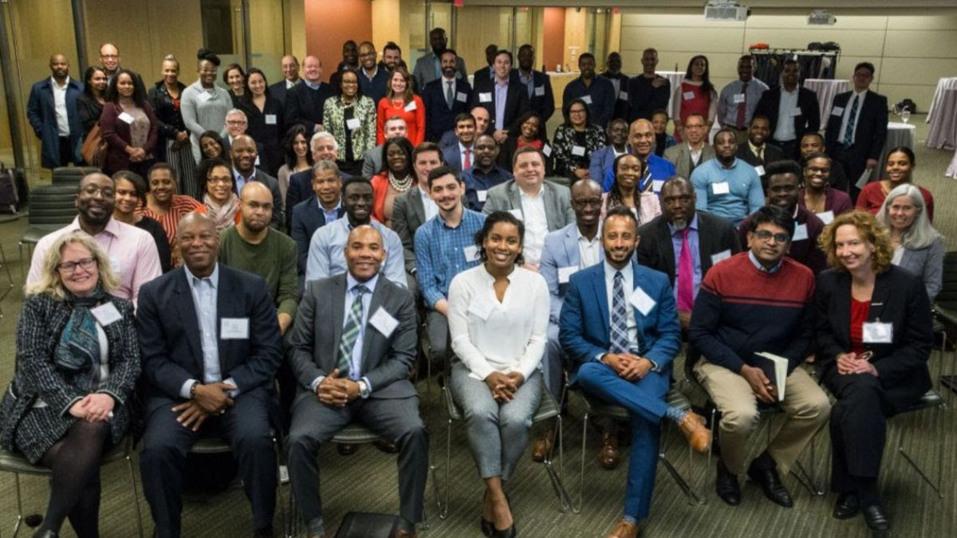
Builders of Color Coalition

Slide 15
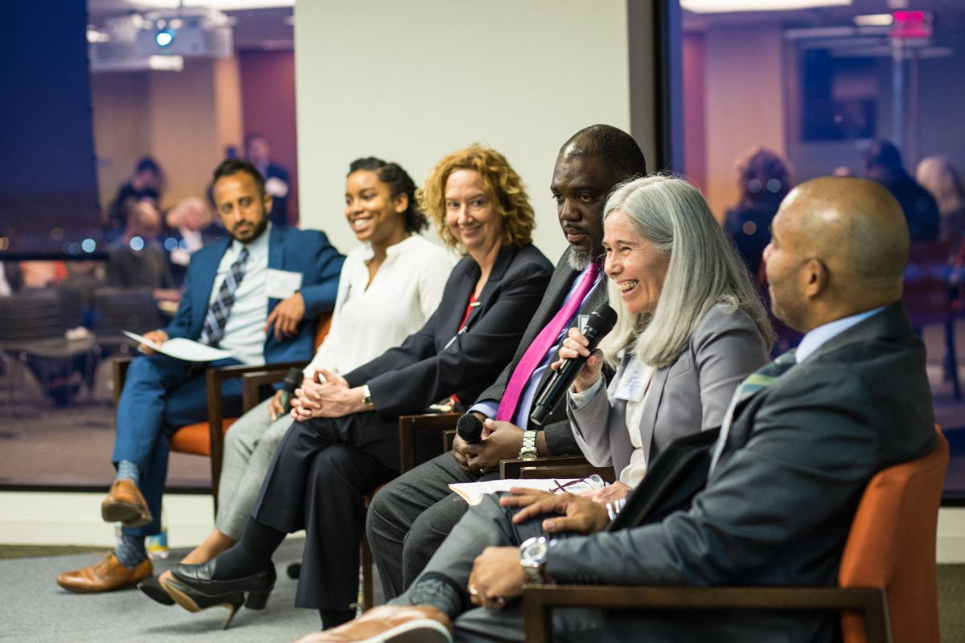
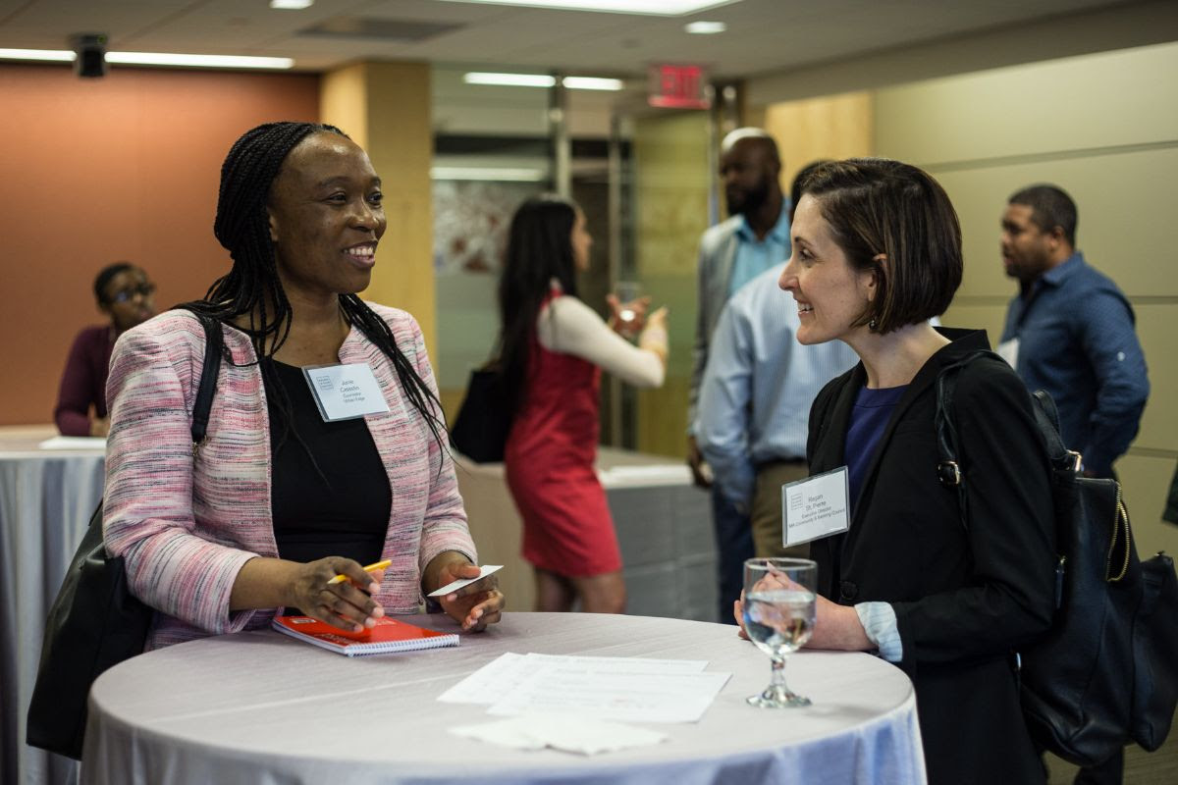
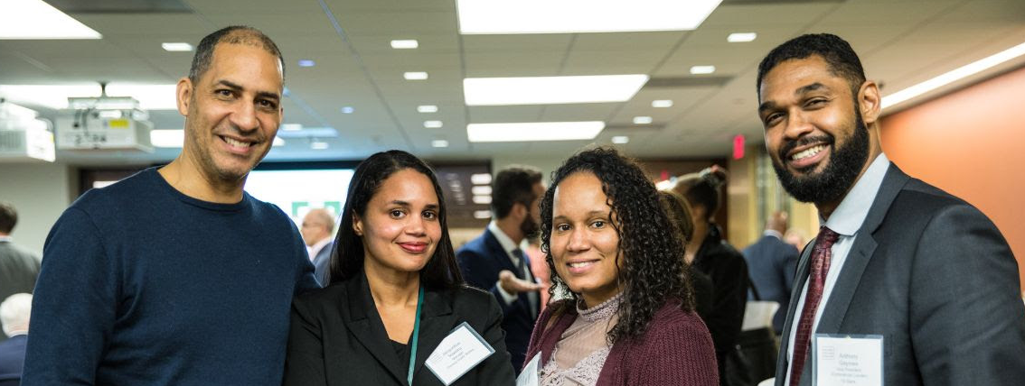
Builders of Color Coalition

