Slide 1
Mortgage Lending Committee
May 21, 2019

Slide 2
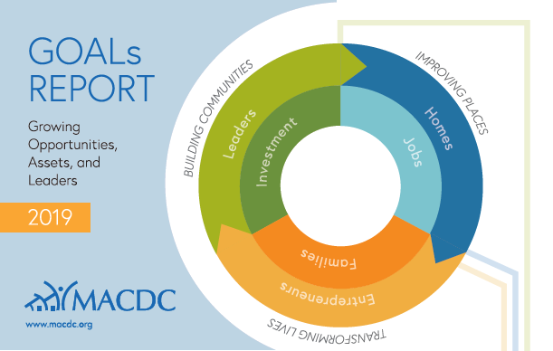
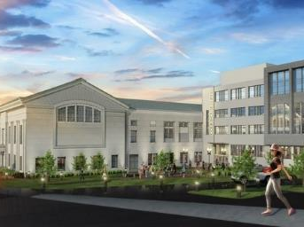
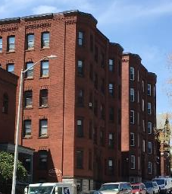
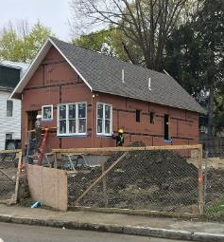
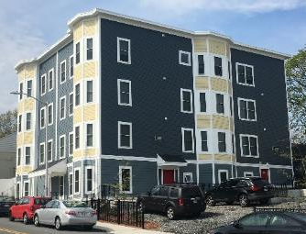
Current Housing Initiatives in Worcester
Worcester CDC Initiative: CEDAC/MHP/Clark/CDCs
Coalition for a Healthy Greater Worcester: CHIP/CHA
Chamber of Commerce: Worcester Housing Market Analysis:
Smart Growth Economics: Mahesh Ramachandran
Complete by August 2019
City of Worcester:
Impediments to Fair Housing: HUD 5-yr plan (w/CMRPC)
Employee Down Payment Initiative
Worcester Multifamily Design and Rehab Guide
Union Hill Revitalization Initiative (2015)
Yes for a Better Worcester Coalition: CPA
Worcester Interfaith: Affordable Housing Coalition
Refugee Housing Study: Clark/Ascentria/City
What are the goals for Worcester?
Worcester Courthouse
Wellington Community
20-24 Merrick Street
1 Kilby Street
Affordable Housing Investment in Worcester

Slide 3
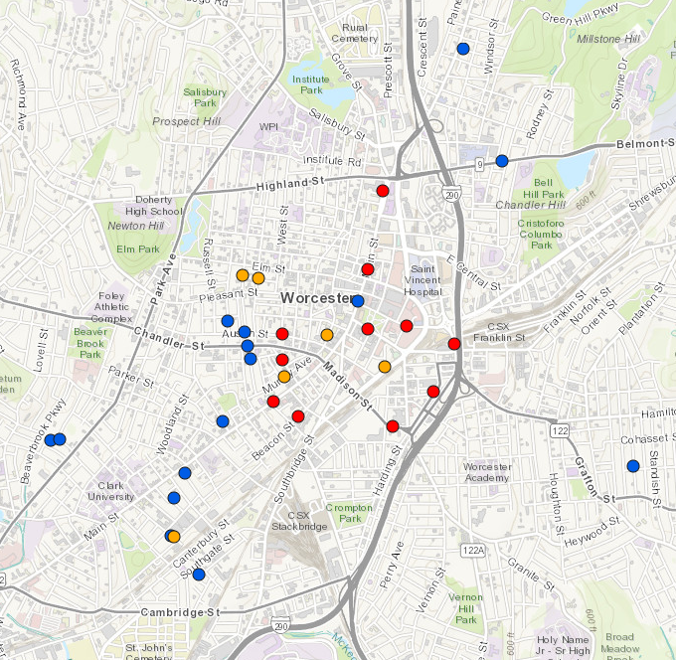
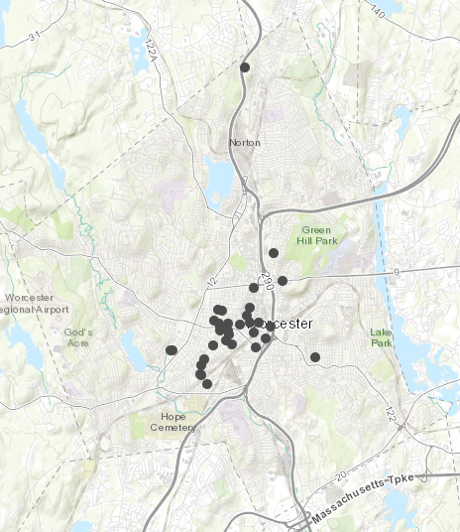
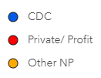
2015-2021 SIGNIFICANT HOUSING PROJECTS
Total investment 2015-2019:
$325 million in 1,742 units
Pipeline through 2020-2021:
$153 million in 890 units
BELL HILL
 | Affordable Units | Market Rate Units | Total Units | Total Dev. Costs (millions)
CDC | 225 | 0 | 225 | $54 mil
Other NP | 351 | 14 | 365 | $83 mil
Private/ Profit | 643 | 1,399 | 2,042 | $341 mil
Grand Total | 1,219 | 1,413 | 2,632 | $478 mil
Distribution | 46% | 54%
ELM PARK
SHREWSBURY ST
PLEASANT ST
DOWNTOWN
PIEDMONT
CANAL
Data not available for all projects
OAK HILL
MAIN SOUTH
VERNON HILL

Slide 4
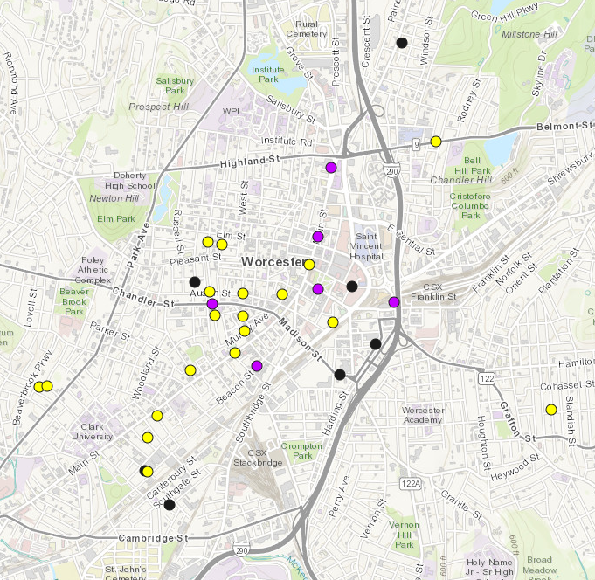
2015-2021 SIGNIFICANT HOUSING PROJECTS
84% of the affordable housing units are rehab investment in the neighborhoods
97% of the market rate units are new or adaptive reuse in Downtown and Canal District
BELL HILL
Project Type 2015-2021: Housing / Mixed Use | Affordable Units | Market Rate Units | Total Units
Rehab | 1,023 | 42 | 1,065
New | 65 | 510 | 575
Adaptive Reuse | 131 | 861 | 1065
Total | 1,219 | 1,413 | 2,632
ELM PARK
SHREWSBURY ST
PLEASANT ST
DOWNTOWN
PIEDMONT
CANAL
OAK HILL
MAIN SOUTH
VERNON HILL

Slide 5
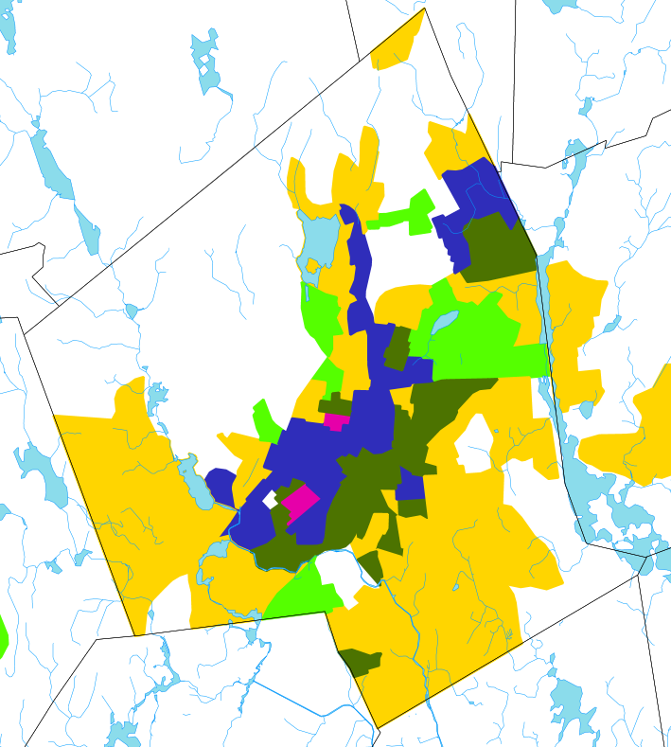
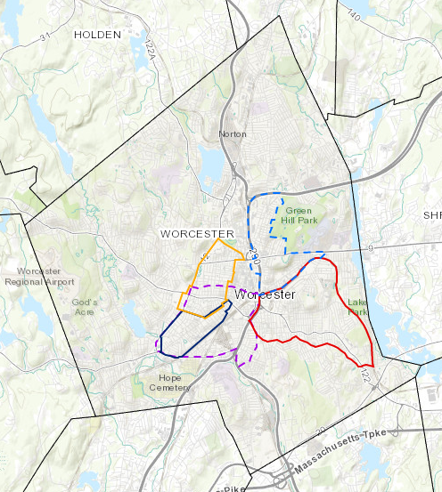
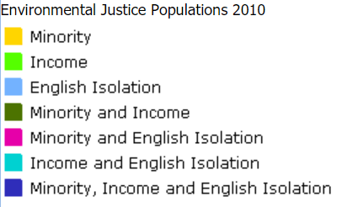
Worcester Geography
http://maps.massgis.state.ma.us/map_ol/ej.php
Main South CDC
Worcester Common Ground
Worcester Community Housing Resources (regional)
Oak Hill CDC
Worcester East Side CDC (est.)
New Americans CDC

